Slide 1
Data Bootcamp Project 1: Fantasy Football
Adam
Blaine
Christian
Jeff

Slide 2
Project Statement
For our project, we analyzed NFL players and their success in the NFL measured in fantasy football statistics. This included looking at a player’s college and their fantasy football success. We also looked at player position and across games within a season.
Motivations:
Interest in football.
Wondering if there were any strong relations between colleges/conferences and fantasy production.

Slide 3
Data questions
What colleges have the highest fantasy output since 2000?
What positions have the highest fantasy output since 2000?
What kind of fantasy production prediction can we make based on a new player’s college or conference?

Slide 4
Data Aggregation and Cleanup
Data from an API available through sportradar.com
This provider is a main source for up to date in game data for the NFL across many platforms involved with fantasy sports.
Limited to using 1,000 calls per API key for free.
Fantasy football data was a simple conversion from football stats.
10 yards = 1 points, 1 TD = 6 points, 1 fumble = -2 points (WR, RB, TE, FB)
25 yards = 1 points, 1 TD = 4 points, 1 fumble = -2 points, 1 interception = -2 points (QB)

Slide 5
Data Aggregation and Cleanup
Steps:
We started by seeing what the JSON data looked like, and grabbed a unique identifier for each NFL team. We exported this list into 'teams_df.csv’.
We then looped through each team in teams_df, and retrieved seasonal stats for that team from each year the service had data from 2000-2016.(1st major issue)
We had to filter the list of 35,000+ rows that contained multiple years of data for each player, and extract a list of unique player IDs. The total unique IDs were ~ 9,000, so we limited the list to offensive players only since they generate the most fantasy points.
The next step in our data collection process was to calculate the amount of fantasy points generated by each player.
To make our job in analyzing the data a bit easier, we also went through each line in a loop, and added a new column that totaled all the points for each player for that year.
Link to jupyter notebook: Football

Slide 6
Data Analysis
In our data analysis for our main question we aimed to show which colleges and which positions had the most productive fantasy football players in the NFL over the last 17 seasons.
We did this by comparing fantasy point production against different cross sections of players based on their college, college conference, and position.
As additional analysis, we did a regression of the scatter plot where we showed the count from a college vs. fantasy point production.
Link to jupyter notebook: Football

Slide 7
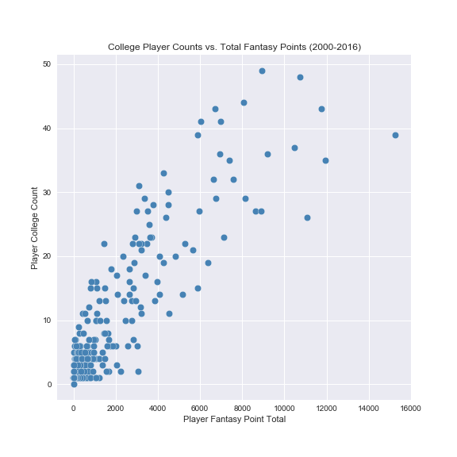
Scatter Plot
 | total points | playercount
Tennessee | 15253.06 | 39.0
Michigan | 11743.12 | 43.0
Ohio State | 8914.76 | 49.0
Penn State | 6694.88 | 43.0
UCLA | 3105.04 | 31.0
Florida | 10727.48 | 48.0
Alabama | 6640.36 | 32.0
Wisconsin | 6991.22 | 41.0
California | 11930.40 | 35.0
Stanford | 6045.58 | 41.0
Michigan State | 9185.64 | 36.0
Florida State | 7383.60 | 35.0
Notre Dame | 8081.64 | 44.0
Oregon | 5871.40 | 39.0
Georgia | 10479.86 | 37.0
Auburn | 7593.54 | 32.0
Oklahoma | 6939.26 | 36.0
Washington | 4257.60 | 33.0

Slide 8
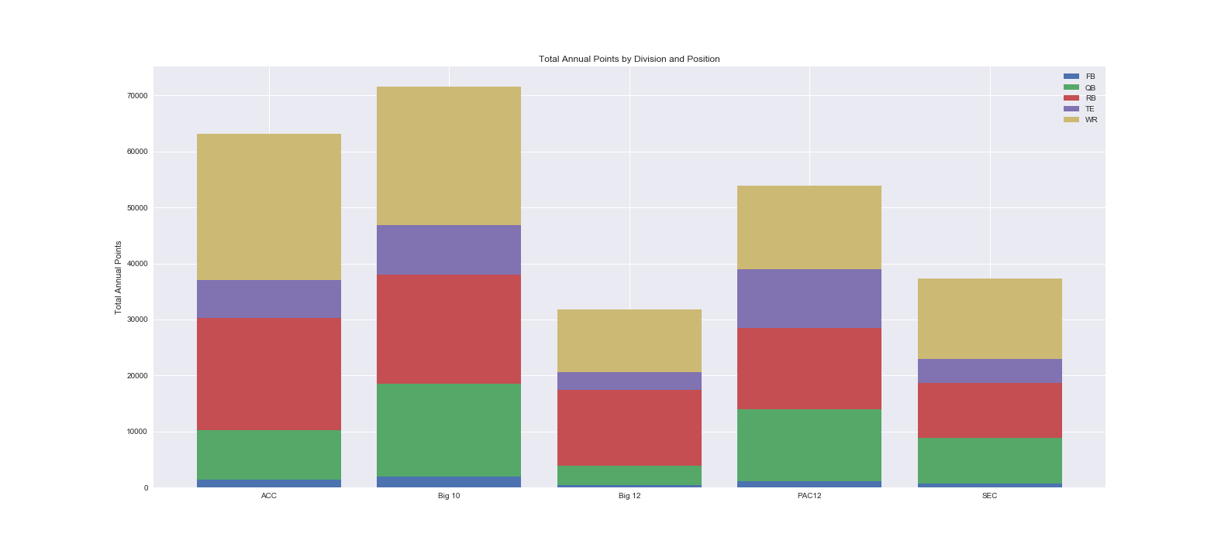
Stacked Bar - Conferences

Slide 9
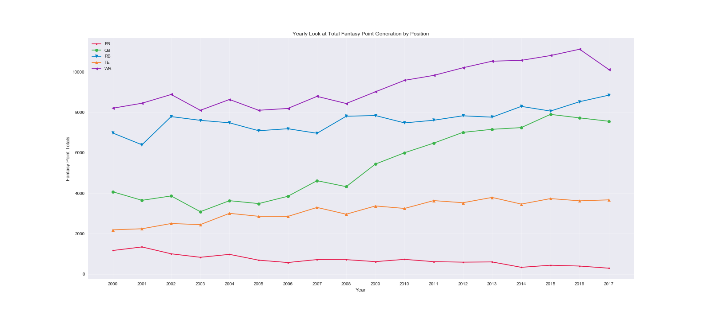
Position line graph

Slide 10
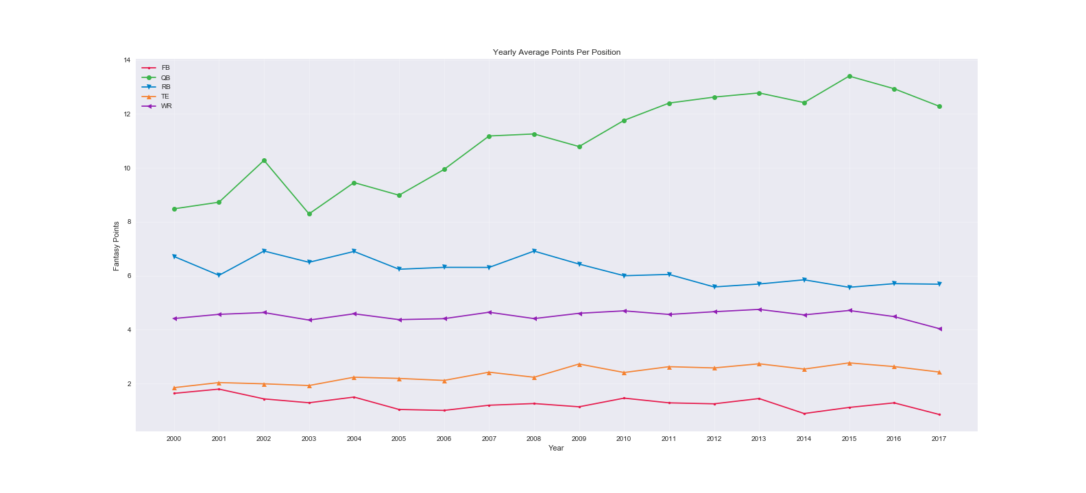
Position line graph: Average Points

Slide 11
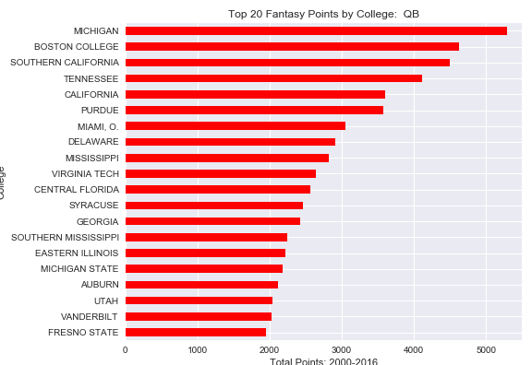
Top colleges - quarterbacks

Slide 12
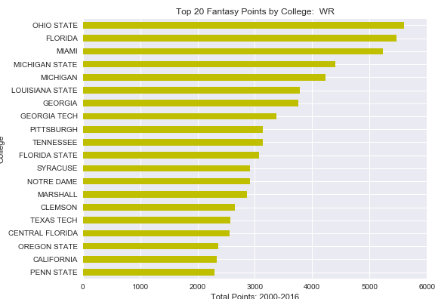
Top colleges – wide receivers

Slide 13
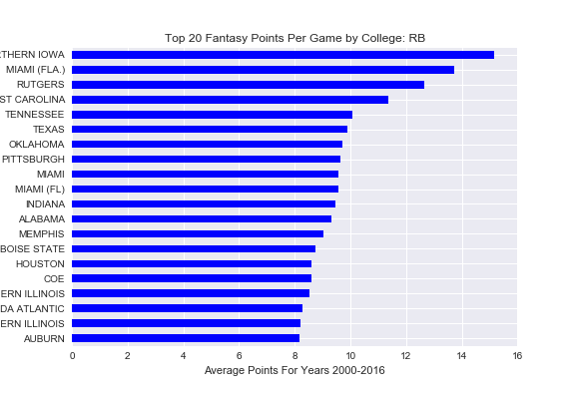
Top colleges – running backs

Slide 14
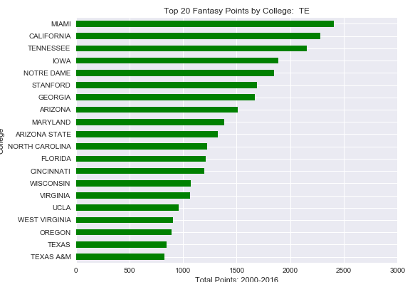
Top colleges – tight ends

Slide 15
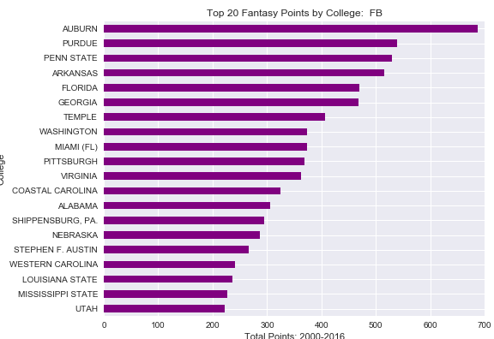
Top colleges – fullbacks

Slide 16
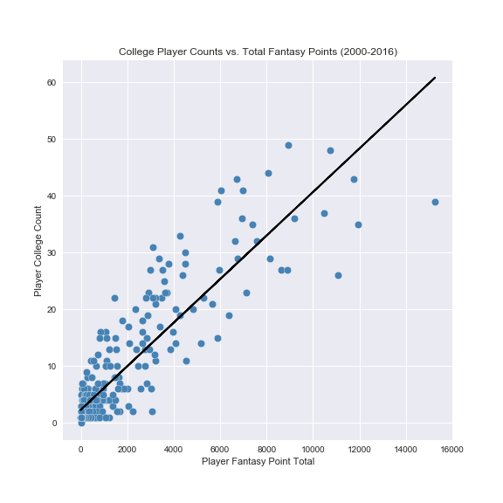
Scatter Plot: REgression
Slope = .0038366969
~260 pts. / player

Slide 17
Additional Analysis
With more time and data we could approach a few different questions, such as:
Which positions are the most valuable? (this depends on scarcity, fantasy football rules and many other factors)
Apply a weighting to positions to help balance the analysis and get a better analysis on what colleges produce the best fantasy football players.
Study measurable information (height, weight, 40 meter dash, shuttle time, etc.) and combine that info with opportunity to predict the best fantasy output.

Slide 18
Summary
What colleges have the highest fantasy output since 2000?
UT(TN) showed the highest fantasy output per player while the Big 10 had the most output for a conference.
What positions have the highest fantasy output since 2000?
WR has become the top position for fantasy output since 2000 and does not look like that will change soon.
What kind of fantasy production prediction can we make based on a new player’s college or conference?
On average a player should be expected to produce ~260 points over 17 seasons or ~14 points a year.

